Slide 1
Review – distribution of discrete random variable
Binomial distribution:
n trials (n is fixed in advance)
each trial: either success or failure
Probability of success (p) remains the same throughout the trials
All trials are independent
Binomial Random Variable:
X = the number of successes after n trials
X~Binom(n,p) P(X=k) = ?
E(X) = np
Var(X) = np(1-p)

Slide 2
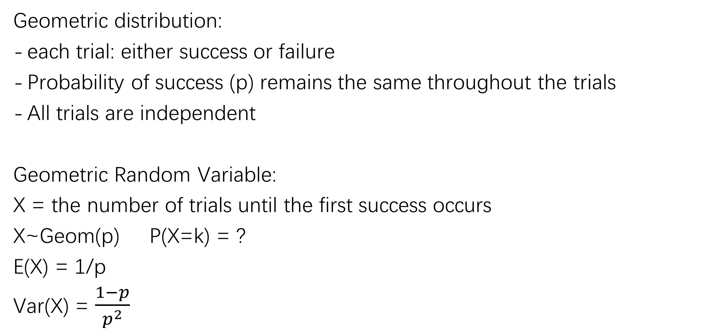
Review – distribution of discrete random variable
Geometric distribution:
each trial: either success or failure
Probability of success (p) remains the same throughout the trials
All trials are independent
Geometric Random Variable:
X = the number of trials until the first success occurs
X~Geom(p) P(X=k) = ?
E(X) = 1/p
Var(X) = $\frac{1−p}{p^{2}}$

Slide 3
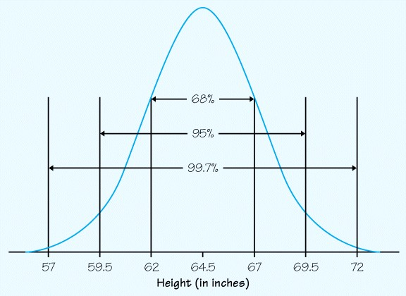
Density Curves

Slide 4
Density Curves for Continuous random variables

Slide 5

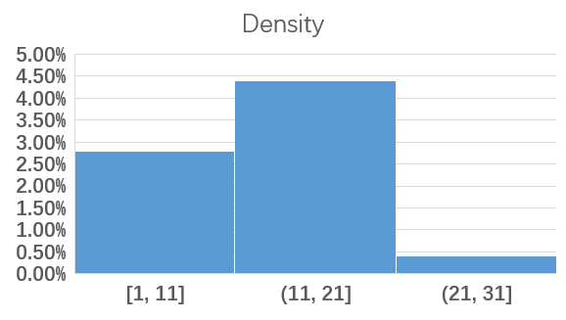
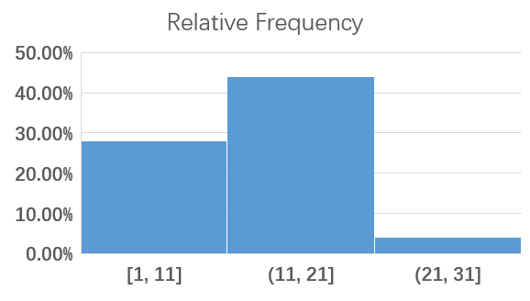
Density
Relative Frequency = density * interval width
Notes:
先回顾一下Density是什么？
在学习histogram的时候，我们把我们的数据分类成不同的区间
横坐标就是区间
纵坐标我们可以设置成Frequency，也就是去计数，不同区间的数据有多少
也可以设置成relative Frequency，也就是不同区间的数据所占比例是多少，比如左图：数据落在11,21这个区间大概有44%
那我们的vertical axis也可以设置成density，不知道大家还有没有印象… density是 relative Frequency 除以 区间的长度，也就是relative Frequency 等于我的纵坐标density乘以区间长度。这个是不是就是对应的矩形面积？

Slide 6
Density Curves
Density Histogram
working with smooth curves is much easier than jagged histograms
Density Curve
Notes:
那我们看一下density histogram是怎么转化到density curve的
这个有点像微积分的思路

Slide 7
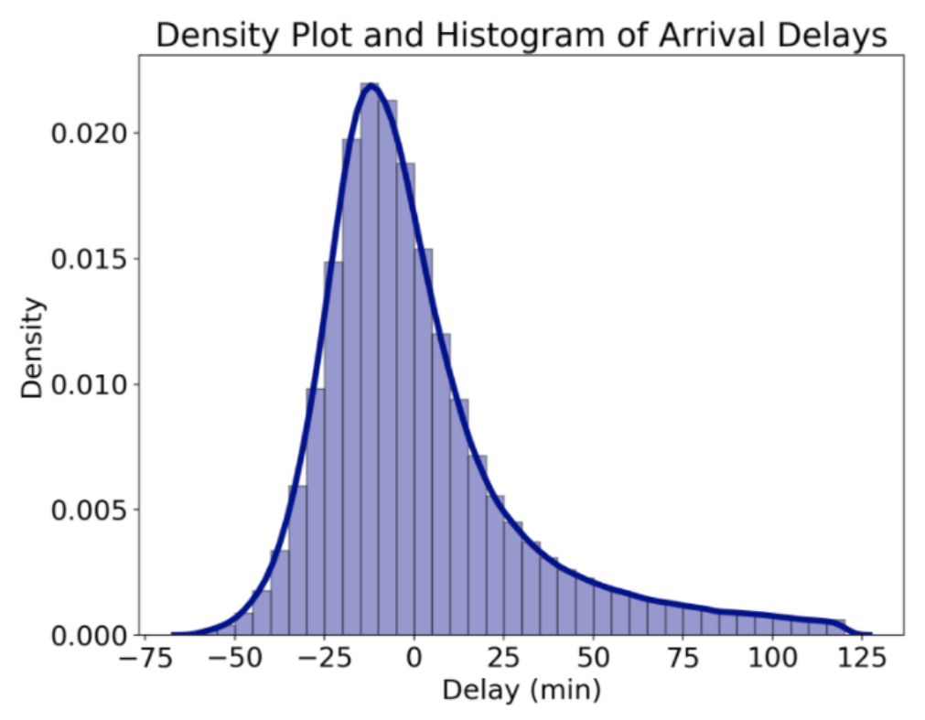
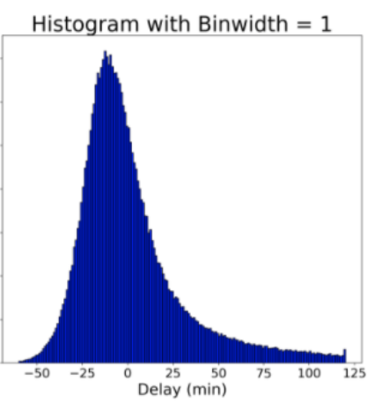
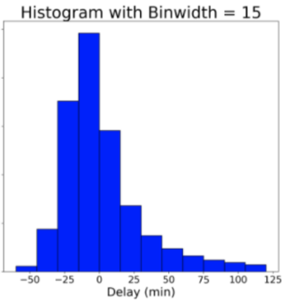
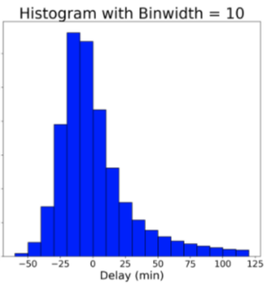
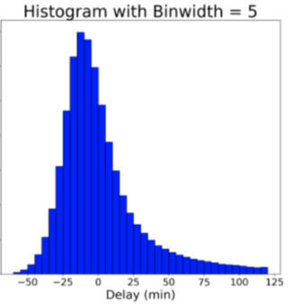
Binwidth-> 0
Smooth density curve!!
Discrete -> ctns!!
Notes:
当我们的bin size是15的时候，density histogram是这样的
随着bin size 的减小，也就是分类越来越细，我们的density histogram就会变得越来越平滑，断层越来越不明显
当bin size 趋近于0的时候，我们就得到了一条平滑的曲线，a smooth density curve!
也就从离散变成了连续。
对于continuous random variable，我们就用density curve to describe their Distributions
这条曲线的方程也就叫做概率密度函数 pdf： Probability density function

Slide 8
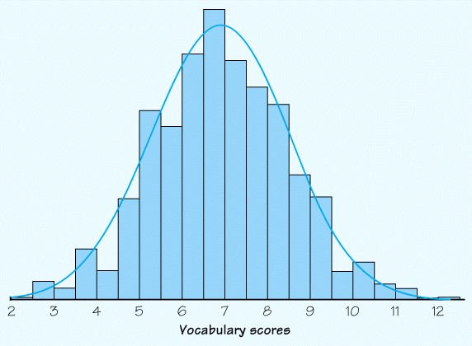
Density Curves
A density curve is a smooth curve that describes the probability distribution for a continuous random variable X.
The function that defines this curve is denoted by f(x) and it is called the density function.
Notes:
看一下正式的定义：
A density curve is a smooth curve that describes the probability distribution for a continuous random variable X.
The function that defines this curve is denoted by f(x)，我们会用fx来表示density function，这个是固定的，不要乱用其他的，and it is called the density function.

Slide 9
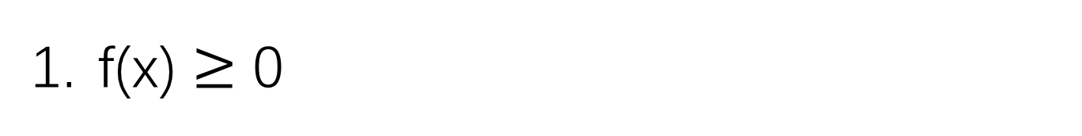
Density Curves -- Properties
f(x) $≥$ 0
Notes:
看一下它的性质
大于等于0

Slide 10
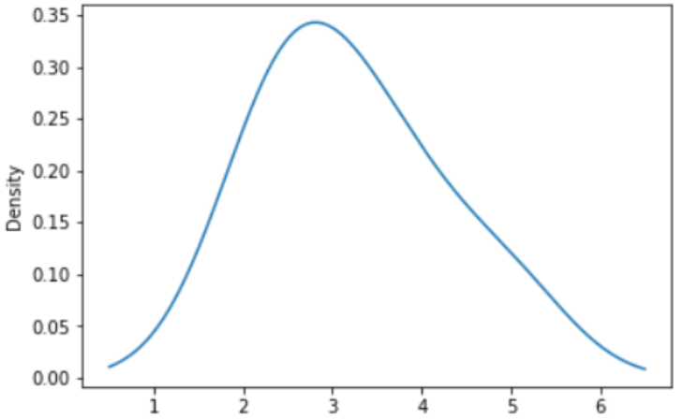
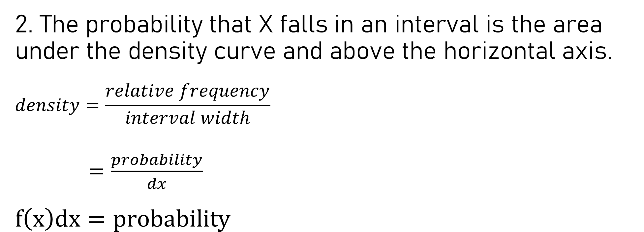

Density Curves -- Properties
2. The probability that X falls in an interval is the area under the density curve and above the horizontal axis.
$$density=\frac{relative frequency}{interval width}$$
$=\frac{probability}{dx}$
$$f\left(x\right)dx=probability$$
$$\int_{a}^{b}{f\left(x\right)}dx$$
a b
Notes:
The probability that X falls in an interval is the area under the density curve and above the horizontal axis.
因为如果纵坐标是density的话，我们的面积对应的就是概率
density = relative Frequency / interval width 在连续变量的情况下，我们让区间长度趋近于0了，所以就是 dx，
也就是说 density function f(x) * dx = 这一段dx对应的概率
那区间a,b对应的概率应该就是 $\int_{a}^{b}{f\left(x\right)}dx$,也就是阴影部分的面积

Slide 11
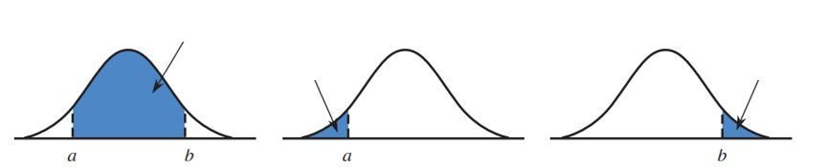
P(a<X<b)
P(X>b)
P(X<a)

Slide 12
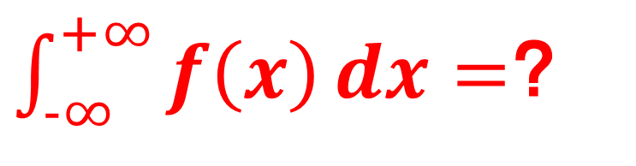
Density Curves -- Properties
$\int_{−∞}^{+∞}{f\left(x\right)}dx=$？
3. The total area under the density curve is 1
Notes:
问：f(x) 下的面积总和是多少？
$\int{f} dx= \sum{p}$，全集的概率应该就是1

Slide 13
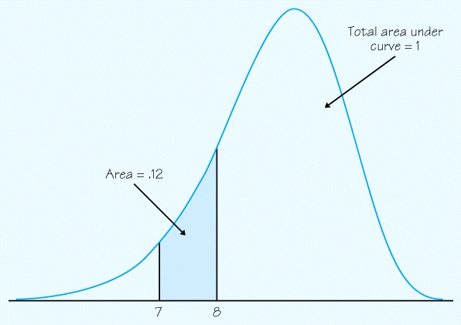
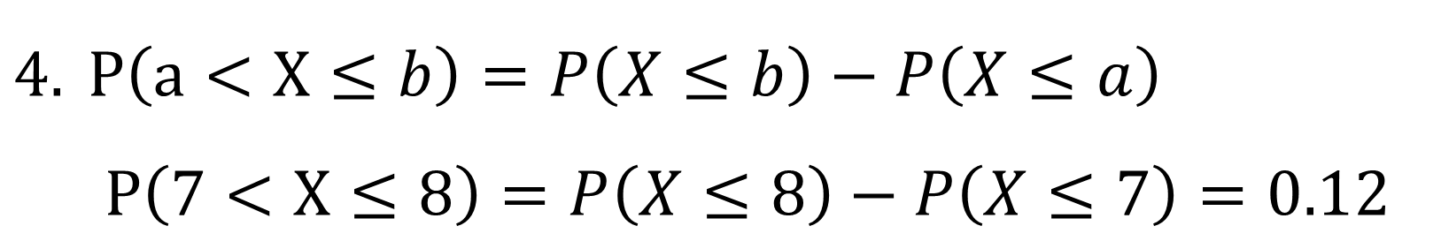
Density Curves -- Properties
$P\left(a<X≤b\right)=P\left(X≤b\right)−P\left(X≤a\right)$
$P\left(7<X≤8\right)=P\left(X≤8\right)−P\left(X≤7\right)=0.12$

Slide 14
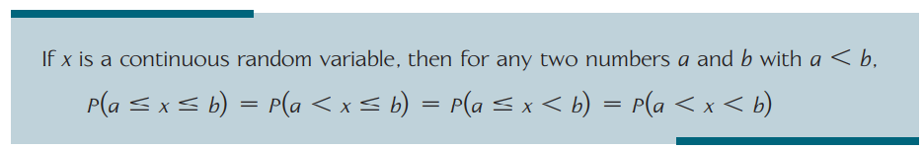
Density Curves -- Properties
P(x=a) = ?
0
Notes:
对于连续型随机变量来说，某一个点的概率是0
所以:

Slide 15
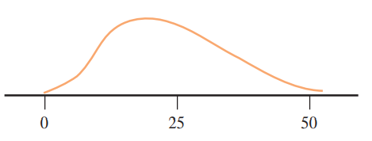
Practice:
Let X denote the lifetime (in thousands of hours) of a certain type of fan used in diesel engines. The density curve of X is as pictured.
Shade the area under the curve corresponding to each of the following probabilities
P(X<30)
The probability that the lifetime is at least 25,000 hours

Slide 16
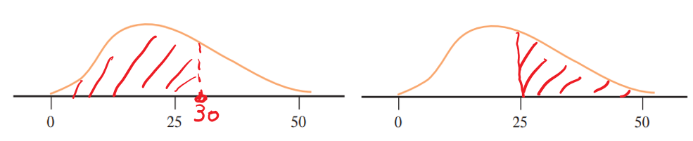

Slide 17
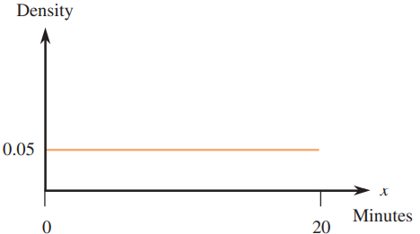
Practice:
Let X be the amount of time (in minutes) that a particular San Francisco commuter must wait for a BART train. Suppose that the density curve is as pictured (a uniform distribution):
a. What is the probability that X is less than 10 minutes? more than 15 minutes?
b. What is the probability that X is between 7 and 12 minutes?
c. Find the value c for which P(X<c) = 0.9

Slide 18
Practice:
What is the probability that X is less than 10 minutes?
P(X<10) = 0.5
more than 15 minutes?
P(X>15) = 0.25
What is the probability that X is between 7 and 12 minutes?
P(7<X<12) = 0.25
Find the value c for which P(X<c) = 0.9
c = 18

Slide 19
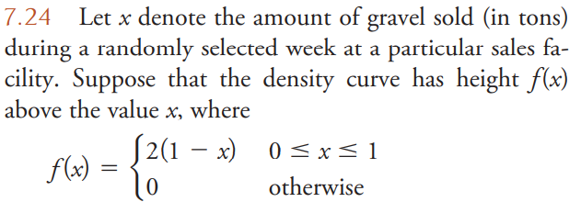
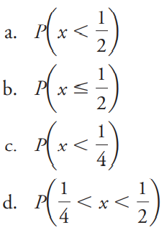
Hint: Use the results of Parts (a)–(c)

Slide 20
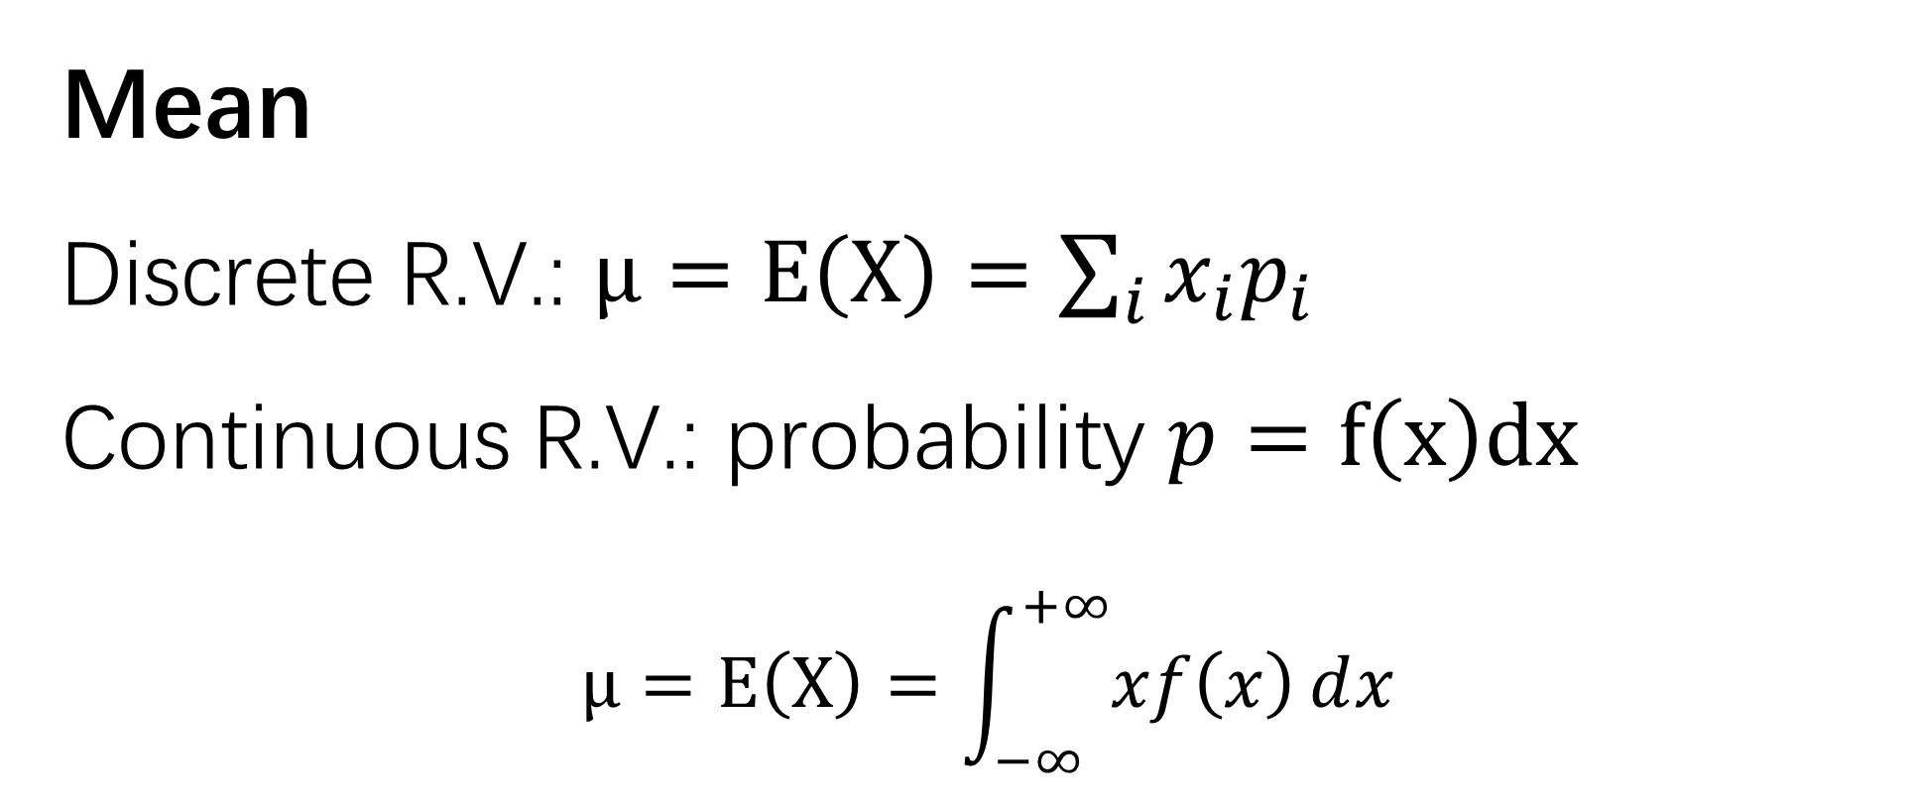
Mean
Discrete R.V.: $μ=E\left(X\right)=\sum_{i}{x_{i}p_{i}}$
Continuous R.V.: probability $p=f\left(x\right)dx$
$$μ=E\left(X\right)=\int_{−∞}^{+∞}{xf\left(x\right)ⅆx}$$

Slide 21
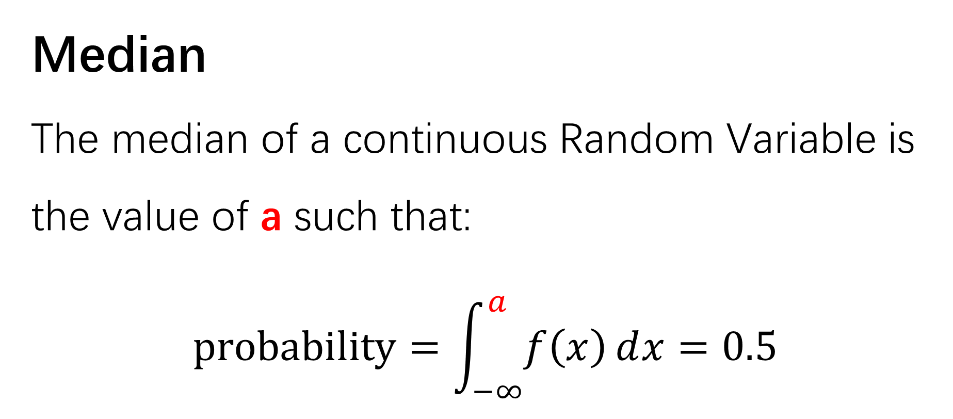
Median
The median of a continuous Random Variable is the value of a such that:
$$probability=\int_{−∞}^{a}{f\left(x\right)ⅆx}=0.5$$

Slide 22
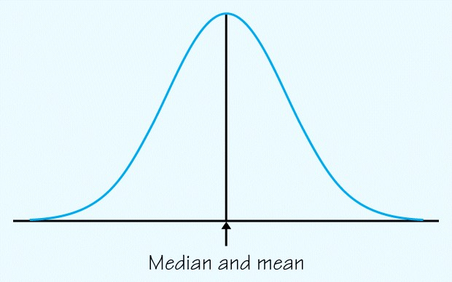
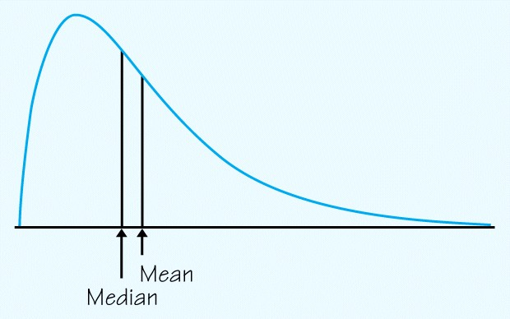
For a symmetric Density curve…
For a skewed density curve…

Slide 24
